Slide 1
Health Affairs Directorate

Slide 2
INTRODUCTION

Slide 3
We all know the ministry of health , employees works for and the purpose of this ministry
This ministry is based on hospitals which are responsible for treating patients .
In hospitals many of employees with different specialization like doctors nurses, Pharmacist Specialist in physiotherapy ,Specialist in nursing , Nursing technician and Ray technician
Ministry is responsible for all process that occur for all employees like nominations,vacation,adjustment,transfer and take down.
Ministry don’t make these process with her own.

Slide 4
Ministry is an organization with sub-organization responsible for all process defined pervious.
These sub-organization called “Health Directorate”
Health directorate existed in each governorate , checking process for only employee in this governorate
Because of this staff of employee have important role in our society , our project will based on organizing all these processes and resources for health directorate.

Slide 5
PROBLEMS

Slide 6
All transactions occurs in health directorate is based on lots of paper.
Staff is suffering from these transactions which make entering or retrieving data it so difficult process
Some data will be lost even if fired or any problems occurs in any rooms of building of directorate .

Slide 7
solutions

Slide 8
Our project will solve a lot of problem of all directorate.
When we convert these paper’s transaction into computerized transaction then we solve lots of problems that facing health directorates in any governorate.
We have centralized repository for data that can be backed up to face any failure.

Slide 9
User requirements

Slide 10
First users suffered from searching in large files and storing data that will waste much time
the system will be helpfull in these cases because it will provide easy retreving and storing data in files
save much time and efforts for the employees and also will decrease number of employees in the organization
facilitate the processes of nomination , vacation ,take-down …etc
help the organization perform and run better.

Slide 11
FUNCTION REQUIREMENT

Slide 12
all of the requirement at the system level that describe the function which the system should do to satisfy the organization which the system made for.
When we insert data for doctors in the database it stored exactly in each field which specified for that is the system validation
Updating and deleting data for doctors and easily checking doctor data like doctor salary.

Slide 13
User should be able to mail any report to management like when we want to know all employees that take a vacation.
And the system should reflect business rules and administrative functions.

Slide 14
NON-FUNCTION REQUIREMENTS

Slide 15
Security make the system safety and can't be hacked.
Performance make the best use of resources and it doesn't waste it like memory and cpu and should be stable and doesn't raise bugs for users
Cost not only in the software itself but also in the computers runs the system
Flexibility the system should have obvious graphical user interaface and easy to use and can be maintainable.

Slide 16
Departments

Slide 17
We can deal with this jobs in many processes like :
Nomination
Vacations
Adjustment
Files
Take-down
Transfer and Deputation

Slide 18
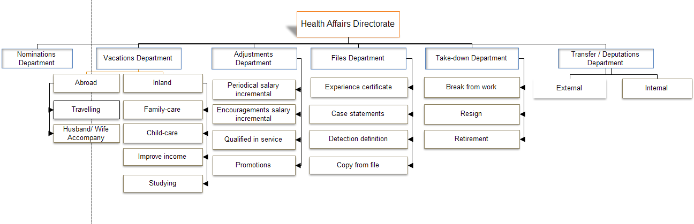
Hierarchy

Slide 19
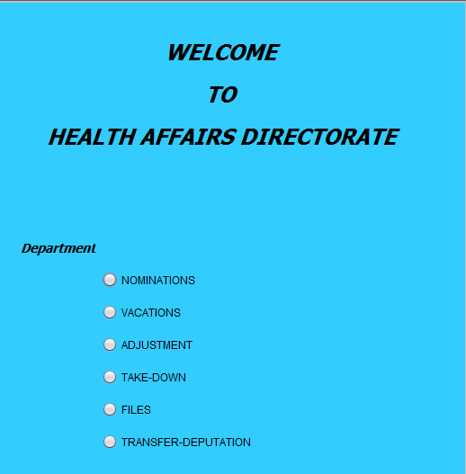

Slide 20
NOMINATIONS

Slide 21
Nomination Scenario
Doctors provide the request for commission work.
When the ministry issue a decision for their nomination , then doctor provide medical examination.
Doctors should present required papers like ( identity-card / birth certificate / license to practice).

Slide 22
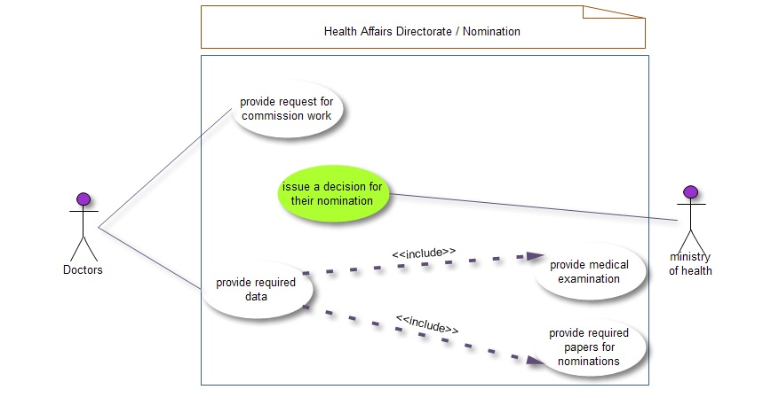

Slide 23
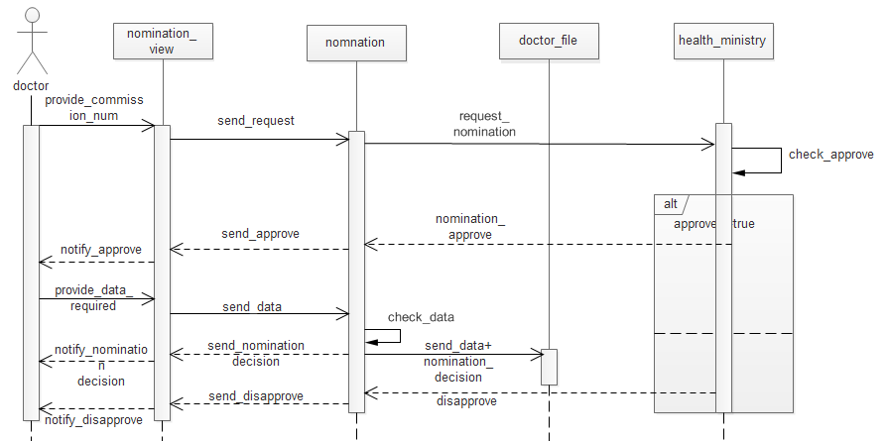

Slide 24
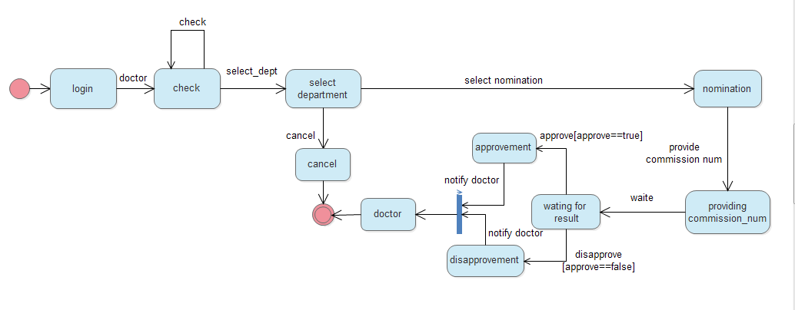

Slide 25
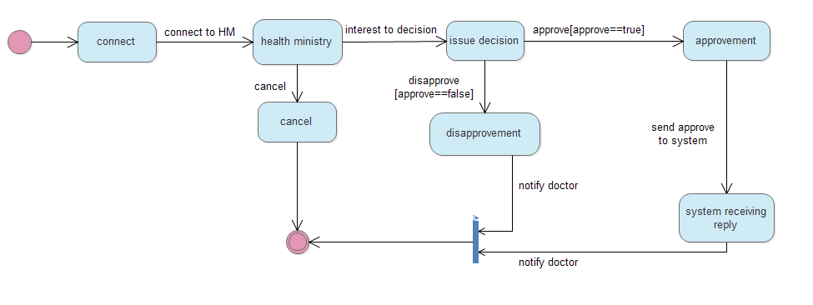

Slide 26
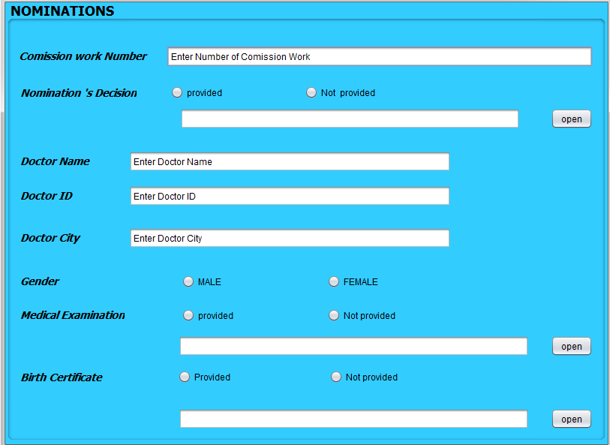

Slide 27
VACATIONS

Slide 28
Vacations Scenario
Vacations can be abroad or inland for work .
Abroad : Travelling abroad
Husband /wife accompany
Inland : Improve income
Studying
Family-care
Child-care

Slide 29
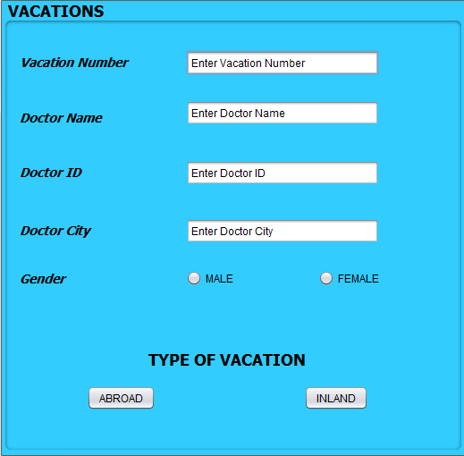

Slide 30
Abroad Scenario
Doctors can be travelling abroad Alone OR Accompany with their husband or wife for working.
They should present required paper like contract , visa, passport , previous vacation and military situation for (male).
The accompany required also the marriage certificate .

Slide 31
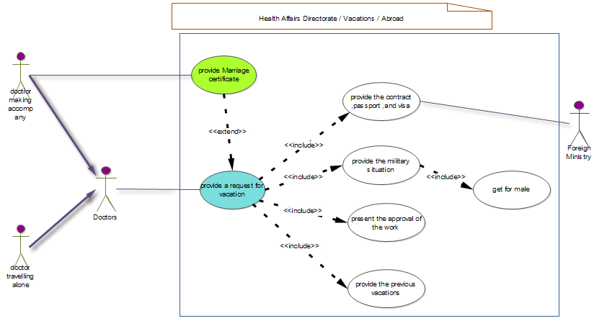

Slide 32
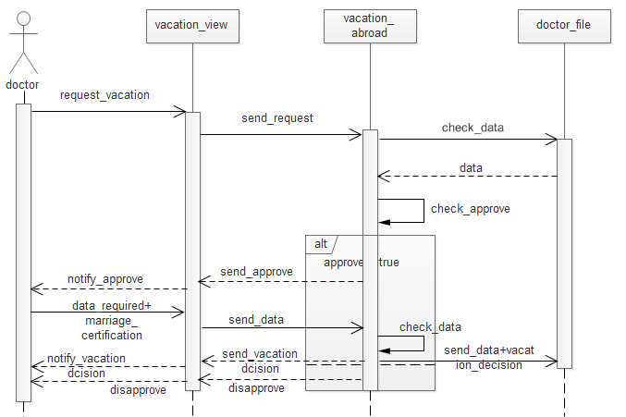

Slide 33
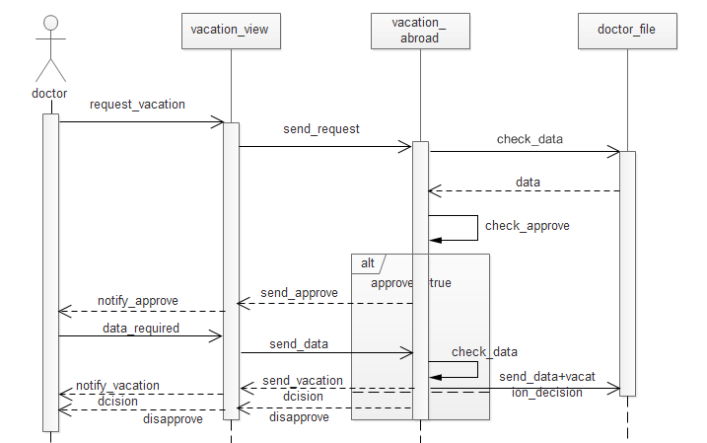

Slide 34
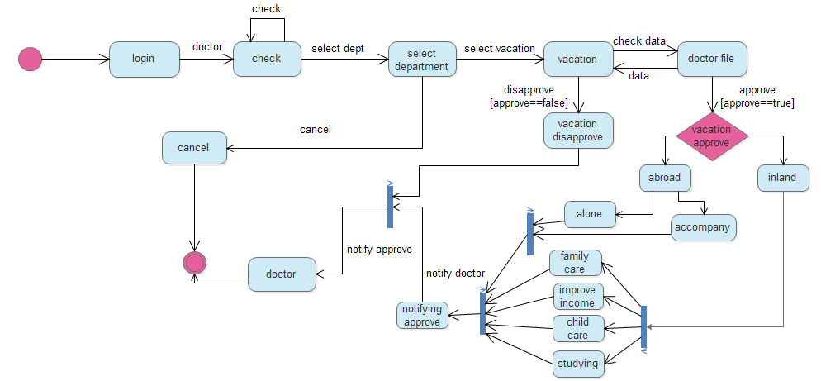

Slide 35
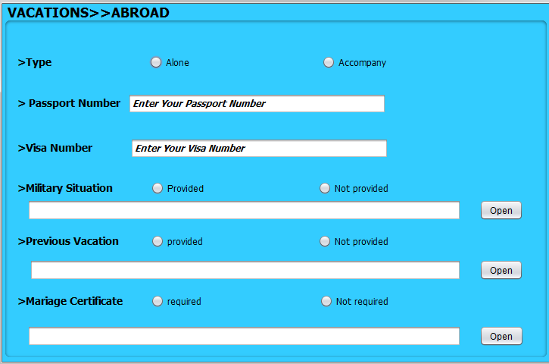

Slide 36
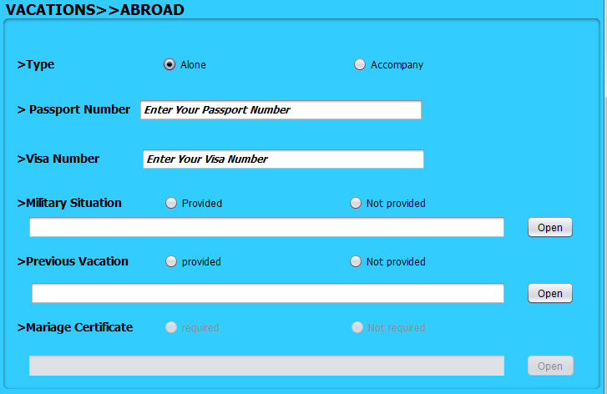

Slide 37
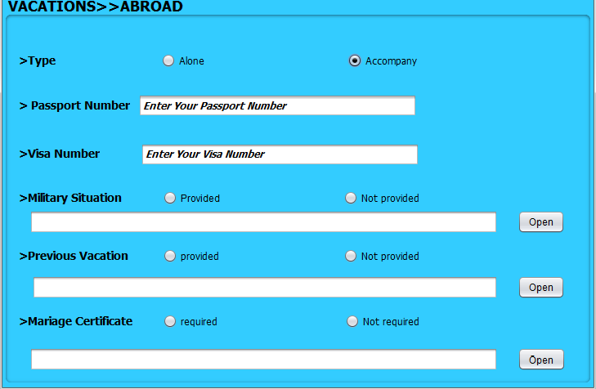

Slide 38
Inland Scenario
Doctors can get vacations for studying ,improve their income , family-care , and child-care.
They all should provide military situation , previous vacation , copy of identity card, approval of their work and payment of pension.

Slide 39
Inland Scenario
Child-care vacation also required birth certificate of the child.
Family-care vacation also required social search .
Studying vacation required letter from the faculty where he studying.
Improve income vacation required presenting internal contract .

Slide 40
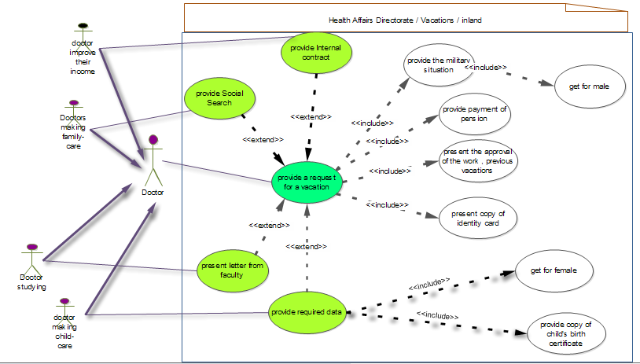

Slide 41
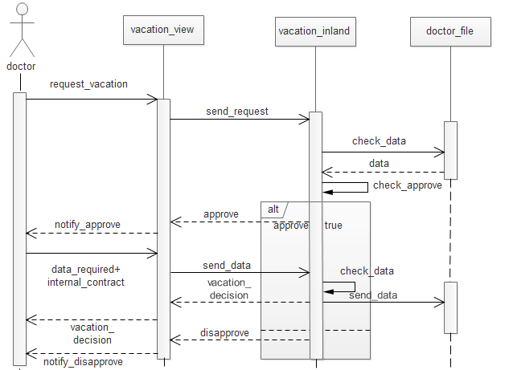

Slide 42


Slide 43
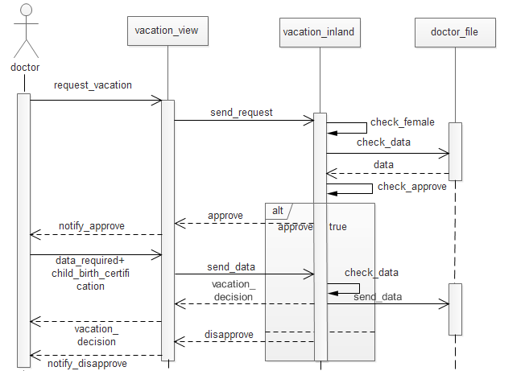

Slide 44
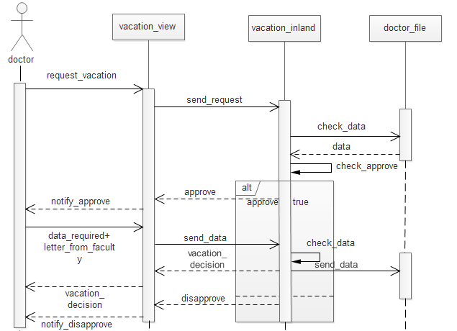

Slide 45
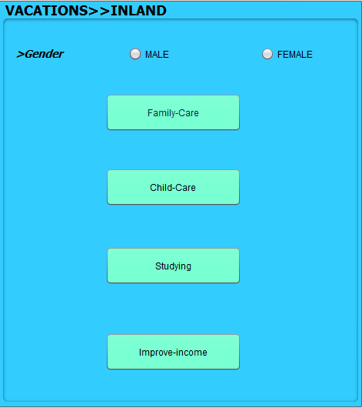

Slide 46
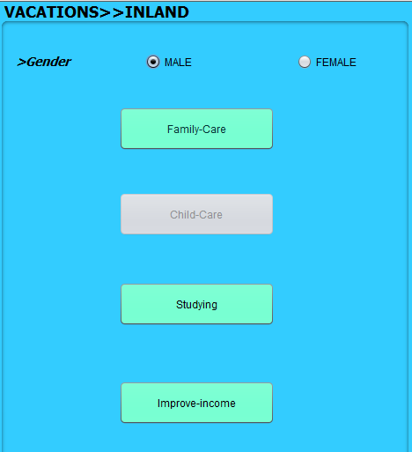

Slide 47
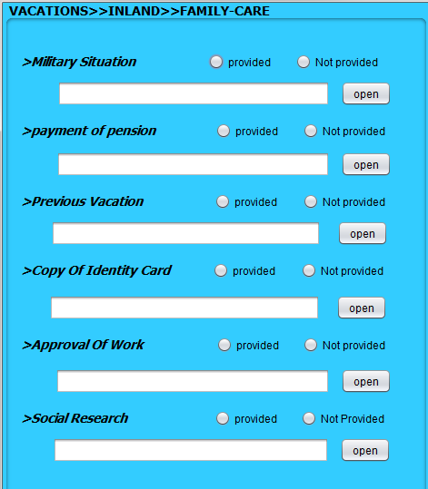

Slide 48
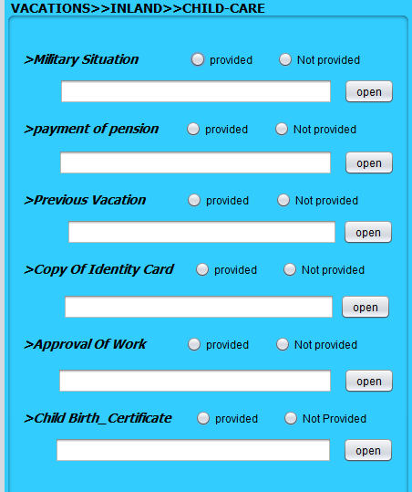

Slide 49
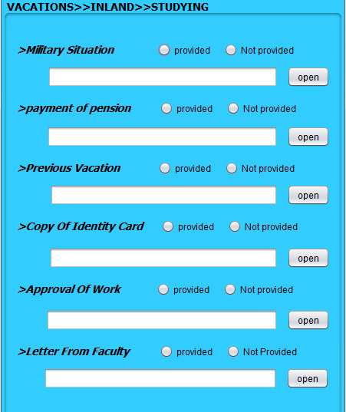

Slide 50
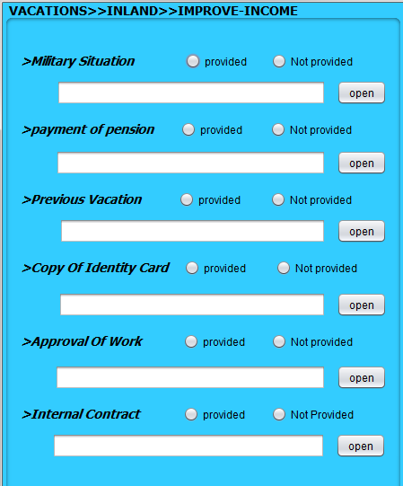

Slide 51
ADJUSTMENTS

Slide 52
Adjustments Scenario
Doctors can get incremental salary which can be Periodical (every year) OR Encouragement( may be in specific months).
Doctors can get promotion while complete specific duration in service.
When doctors get high qualification during service they also get adjustment.

Slide 53
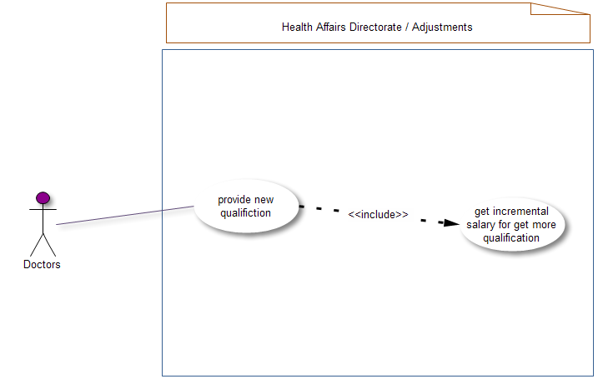

Slide 54
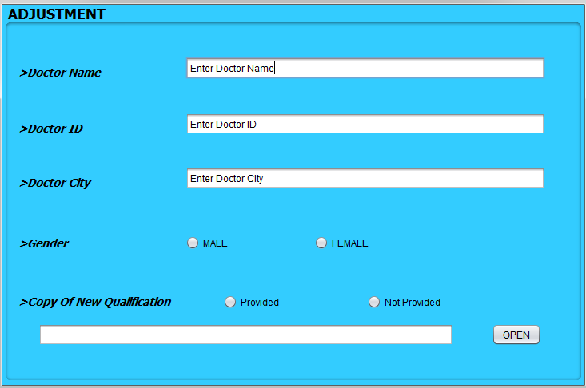

Slide 55
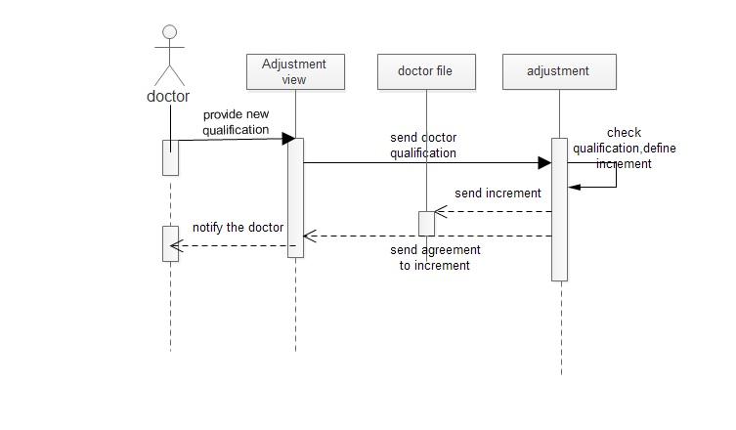

Slide 56
FILES

Slide 57
Files Scenario
Doctors need this department to get some information from their files (CV) like :
Experience certificate
Case statement
Detection definition
Copy from their file
They should a provide a request to can get one or more of these information.

Slide 58
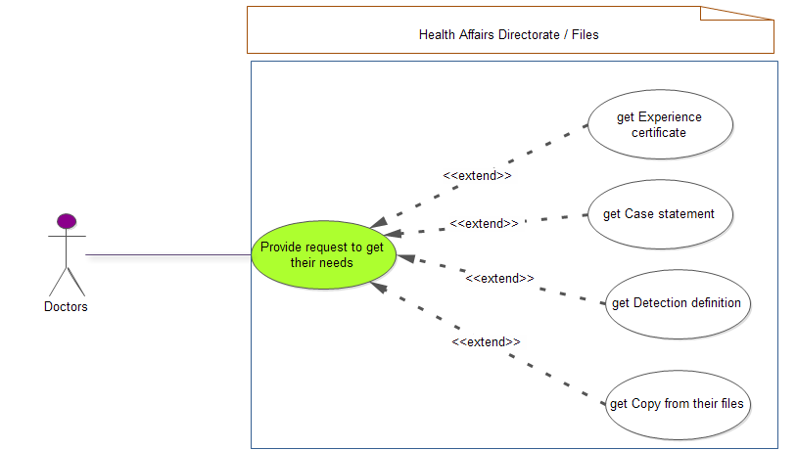

Slide 59
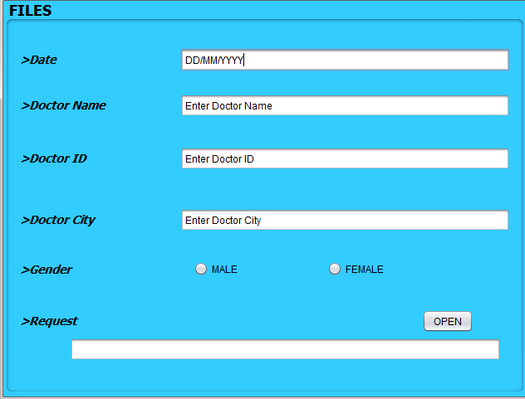

Slide 60
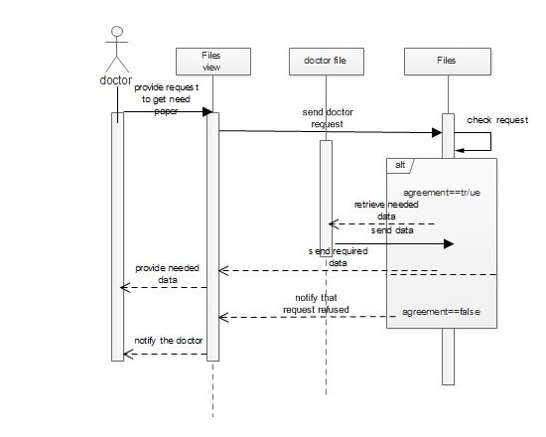

Slide 61
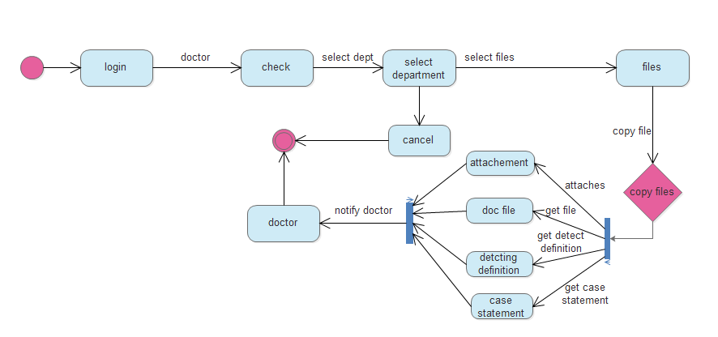

Slide 62
TAKE-DOWN

Slide 63
Take-down Scenario
This department is responsible for :
Break from work ( when doctor break from his work this department issue a decision for dismiss this doctor from his job).
Resignation ( doctor provide a request attached with his resignation).
Retirement ( when doctor be aged and have 60 years old he will be retired )
Die (when doctor die organization will take him down from his work)

Slide 64
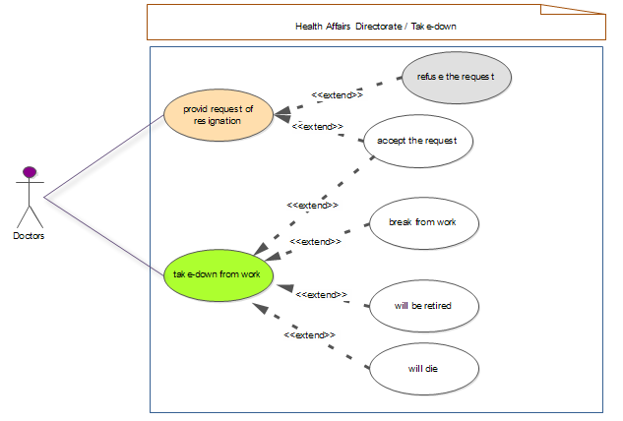

Slide 65
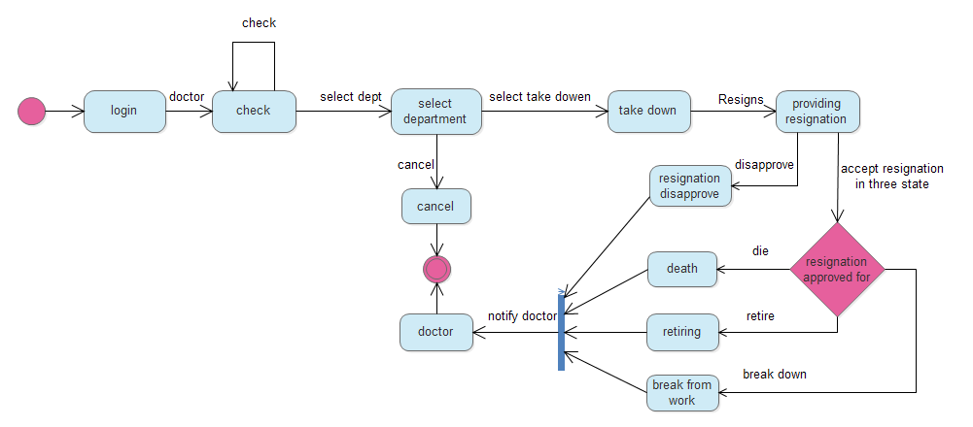

Slide 66
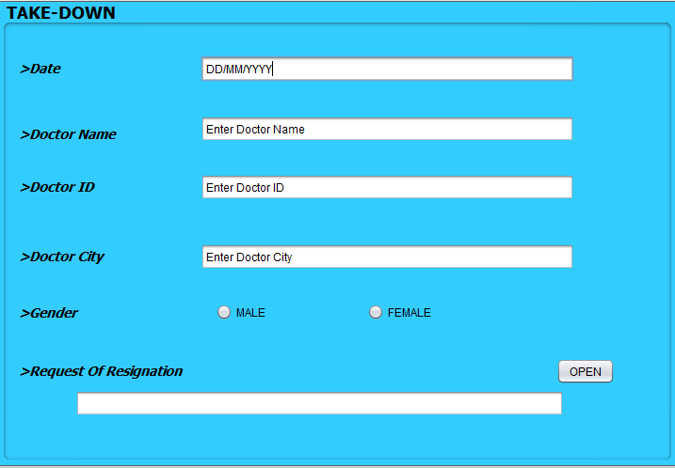

Slide 67
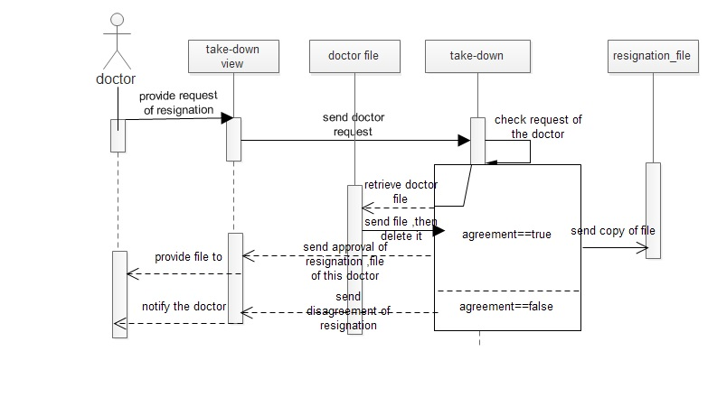

Slide 68
TRANSFER& DEPUTAIONS

Slide 69
Transfer/Deputation Scenario
Transfer when doctor move from his work to another and take all his files from his previous work.
In this case he end his relationship with previous work.
Transfer can be internal or external the governorate.

Slide 70
Transfer/Deputation Scenario
Deputation when doctor move from his work to another and but his files remain in his previous work.
In this case he his relationship with previous work will remain and earn his salary from it.
Deputation can be internal or external the governorate.

Slide 71
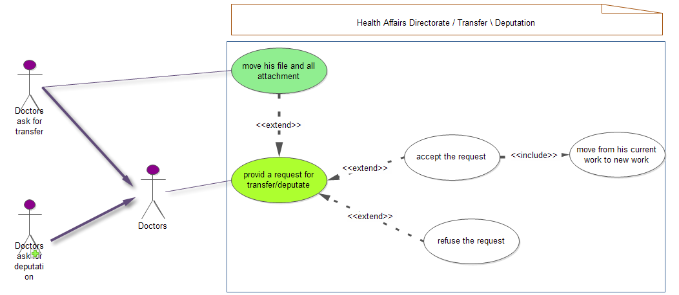

Slide 72
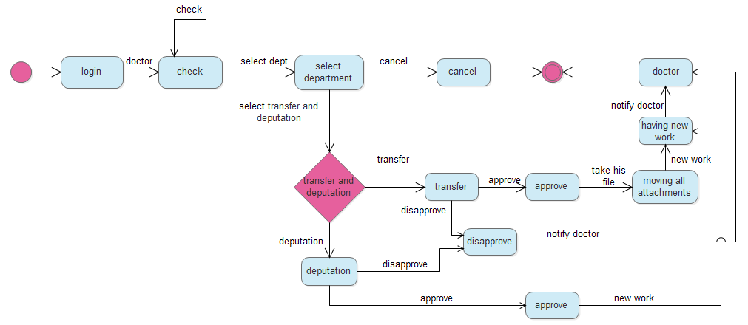

Slide 73
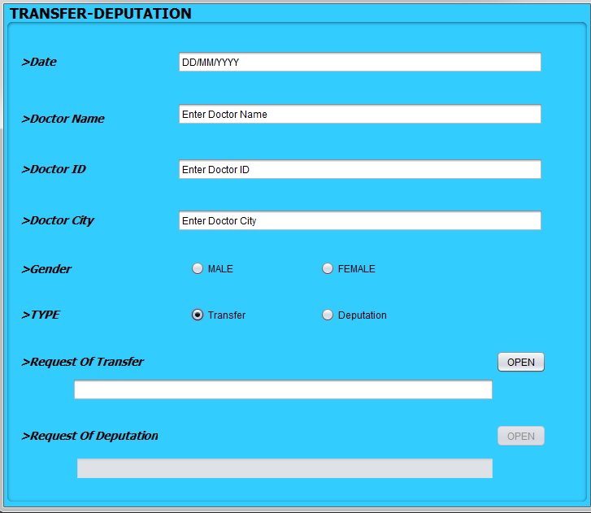

Slide 74
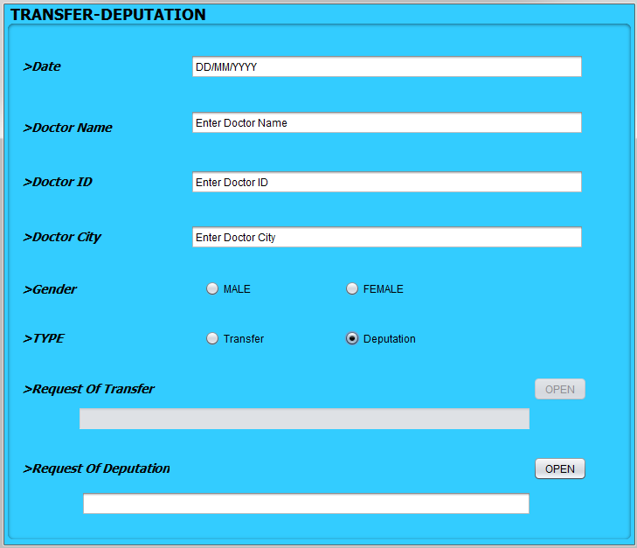

Slide 75
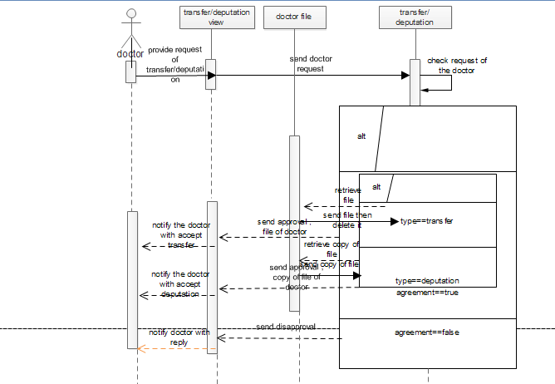

Slide 76
CLASS DIAGRAM

Slide 77
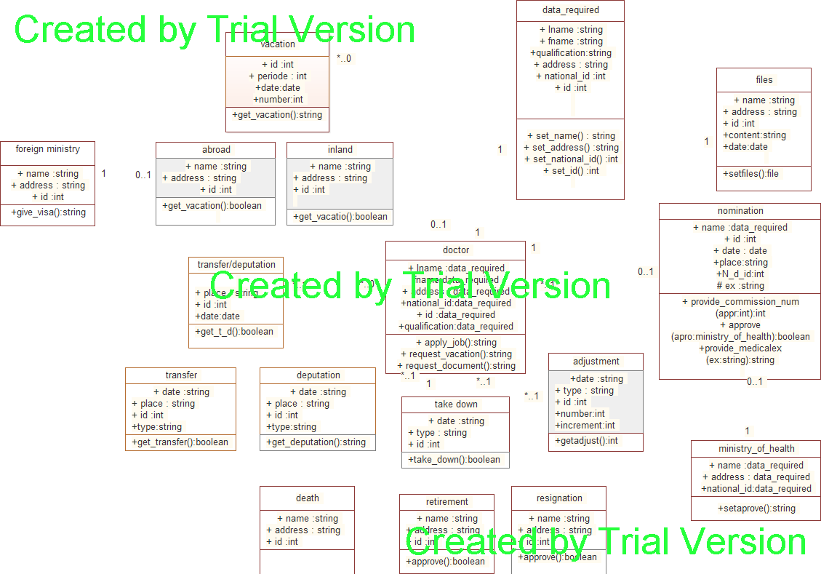

Slide 78
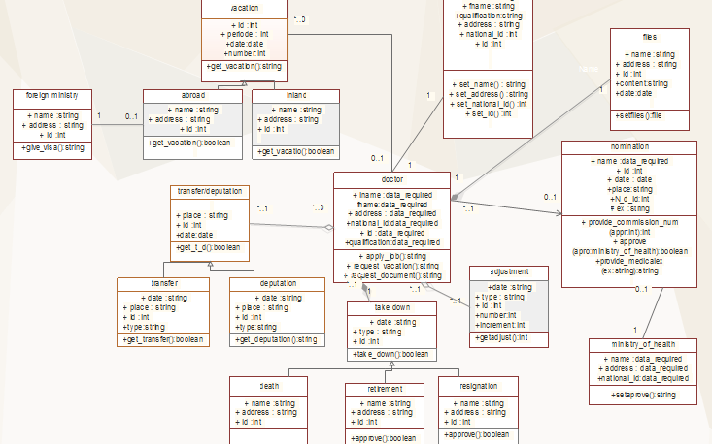

Slide 79
ERD

Slide 80
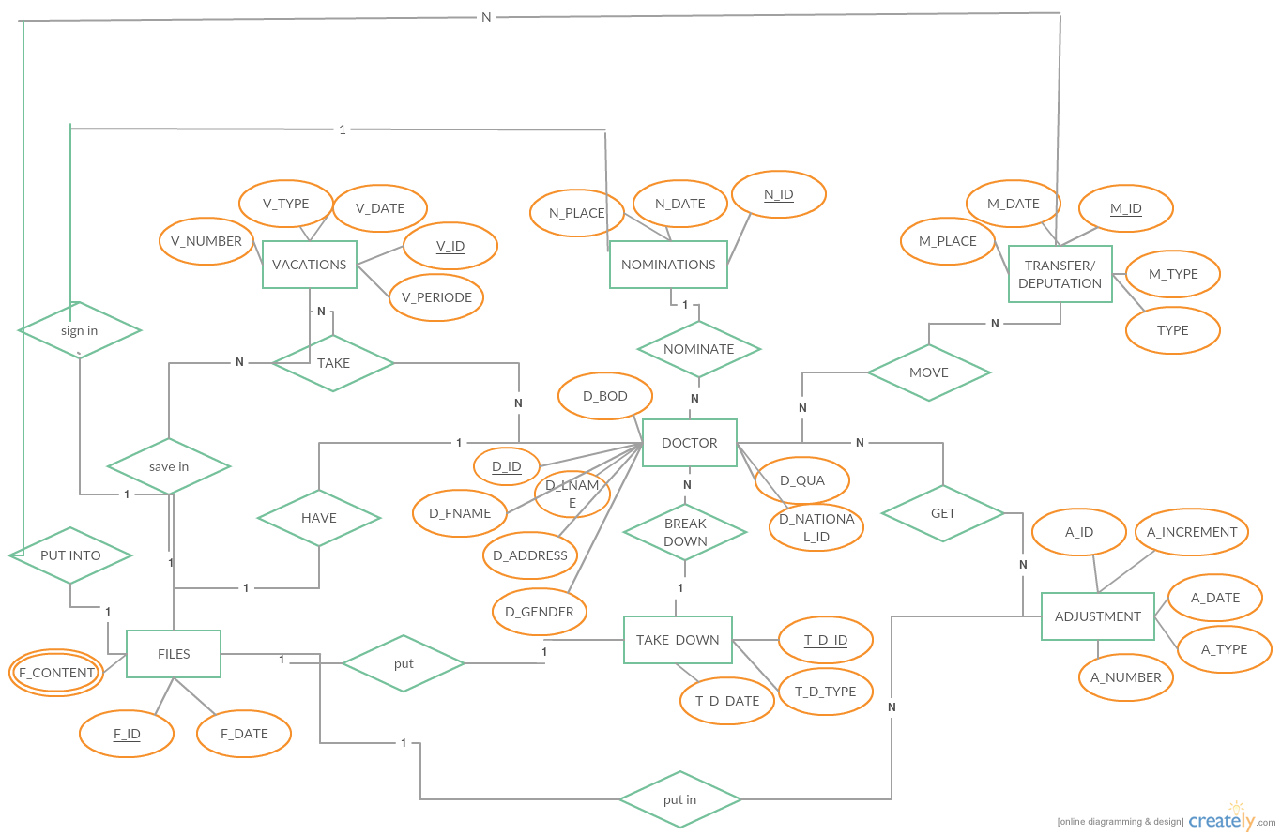

Slide 81
RELATIONS

Slide 82
DOCTOR=>TRANSFER(M:N) DOCTOR=>ADJUSTMENT(M:N) DOCTOR=>VACATION(M:N) DOCTOR=>NOMINATION(M:1) DOCTOR=>FILES(1:1) DOCTOR=>TAKE-DOWN(M:1) …………………………………………………… FILES=>NOMINATION(1:1) FILES=>VACATION(1:M) FILES=>TRANSFER(1:M) FILES=>TAKE_DOWN(1:1) FILES=>ADJUSTMENT(1:M)

Slide 83
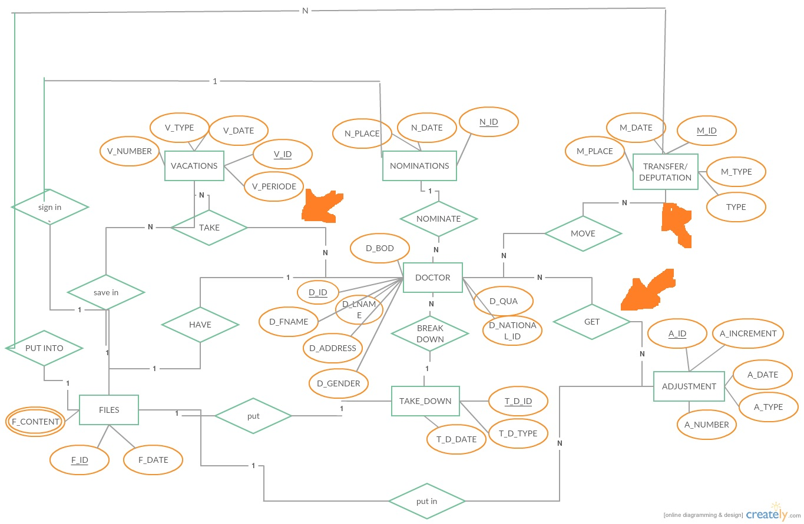

Slide 84
